Slide 1
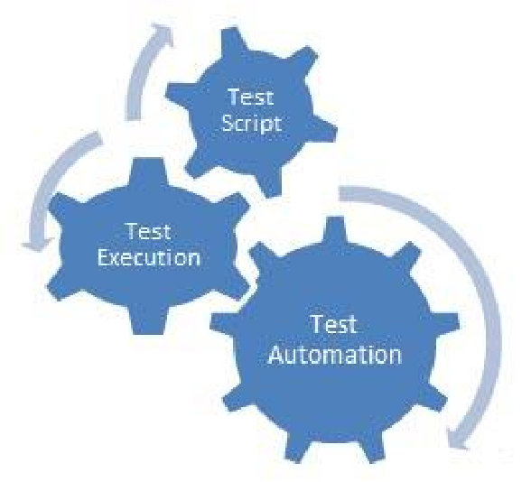

API Test Automation using JMeter
Version | Date | Author | Reviewer | Approver | Details
1.0 | 09/07/2021 | Suresh Byregowda |  |  | First Version
API Automation using Seat

Slide 2




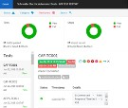

API Test Automation – Using JMeter
JMeter Tool Test Data
CI/CD
Report
Rest API calls
Web Application
JMeter_API_Framework
JMeter is a open source tool for automated API testing.
JMeter API Test framework is 100% script less automation framework
This enabled projects to become highly productive to create automated test script
Fast API testing also Supports load and stress testing
Lots of plugins, extensions and cross-platform

Slide 3
JMeter API Framework Folder Structure
1
Open>>apache-jmeter-5.0>>bin
binaries
config
2
Configure->Config.txt
C:/ JMeter_API_Framework/
3
Run>>JmeterApiFrameWorkv.jmx file in JMeter OR as a batch file
fw
testcases
4
TestData
>>CTX>>Testcases.csv
5
results
Generate reports> reports as html

Slide 4
API Test automation using JMeter
Framework setup : Copy C:\JMeter_API_Framework to test environment/ local system
JMeter installation : C:\JMeter_API_Framework\binaries\apache-jmeter-5.0
To open JMeter, Run the file “C:\JMeter_API_Framework\binaries\apache-jmeter-5.0\bin\Jmeter.bat”
JMeter framework file : C:\JMeter_API_Framework\fw
Open the file “JmeterApiFrameWorkv1.jmx” using Seat
Framework folders
Test Case Folder : C:\JMeter_API_Framework\testCases
Create a Project Folder under testCases (Example: CTX)
Results Folder : C:\JMeter_API_Framework\results
Configuration Folder : C:\JMeter_API_Framework\config
Update the config.txt file for the test execution setup
FRAMEWORK_PATH=C:\JMeter_API_Framework\
TEST_REPORTS_LOCATION=results

Slide 5
API Test automation using JMeter
Create test cases
Test Case Project Folder : C:\JMeter_API_Framework\testCases\CTX
Create a test case file, example: C:\JMeter_API_Framework\testCases\CTX\ExternalAPIs.csv
Configuration Folder : C:\JMeter_API_Framework\config
Update the config.txt file for the test execution setup
TEST_CASE_LOCATION=testCases\CTX\
TEST_FILE_EXECUTE=ExternalAPIs.csv
EXECUTE_TEST_CASES=P1,P2,P3
Update Test Cases with API Setup
Do the manual testing using Swagger/ Postman/ JMeter
Enter the API Setup in the test case csv file
Create the required global variables in config.txt

Slide 6
API Test automation using JMeter
Execution process
Open JMeter : C:\JMeter_API_Framework\binaries\apache-jmeter-4.0
To open JMeter, Run the file “C:\JMeter_API_Framework\binaries\apache-jmeter-4.0\bin\Jmeter.bat”
Or Open from the short cut created in C:\Jmeter_API_Framework
JMeter framework file :C:\JMeter_API_Framework\fw
Open the file “JmeterApiFrameWorkv.jmx” using JMeter
Click on Run → ‘Start’ menu OR Icon
Click on ‘View Results Tree’ for verifying the results/status of execution
Check Results Folder for html report : C:\JMeter_API_Framework\results
Execute using Command prompt
Run following command from the folder: C:\Jmeter_API_Framework\binaries\apache-Seat-4.0\bin
jmeter -n -t C:\JMeter_API_Framework\fw\JmeterApiFrameWorkv.jmx -l C:\JMeter_API_Framework\results/file.jtl

Slide 7
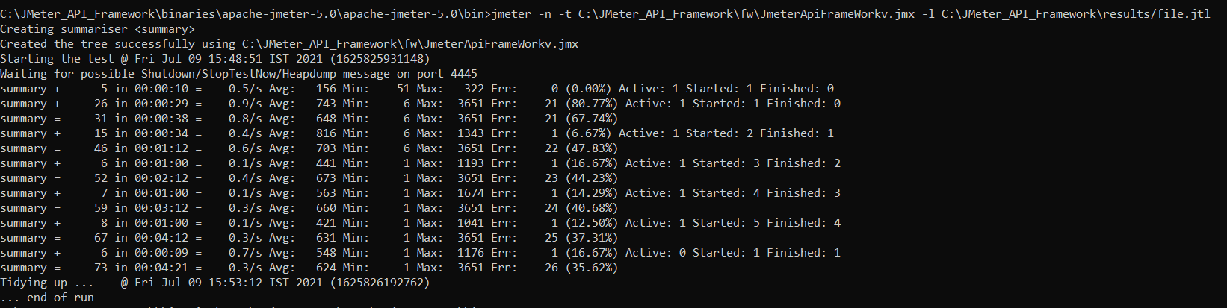
API Test automation Execution using Command Line

